Slide 1
Planning and cabling
CCNA Exploration Semester 1
Chapter 10

Slide 2
Chapter 10 topics
Identify media for a LAN.
Identify cables, connections and standards for a LAN.
Compare straight through and crossover UTP cables
Identify cables, connections and standards for a WAN.
Make and use a console connection to a Cisco device.
Design an addressing scheme for an internetwork.
Compare and contrast network designs.

Slide 3
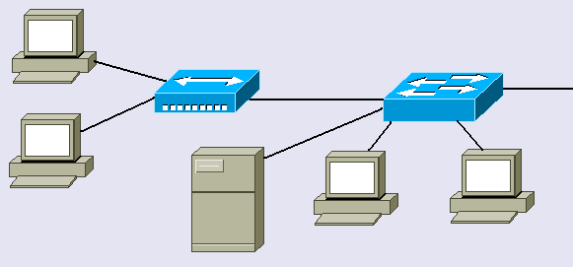
Within a LAN
Hubs and switches link hosts

Slide 4
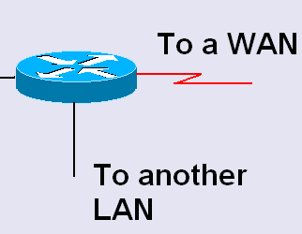
Between networks
Routers link networks together and act as gateways between them.

Slide 5
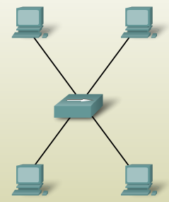
Hub
Frame comes in. Hub regenerates it and forwards it through all ports except incoming port.
Shared medium, shared bandwidth. Hosts are in the same collision domain.
Cheap.
For small LANs only.

Slide 6
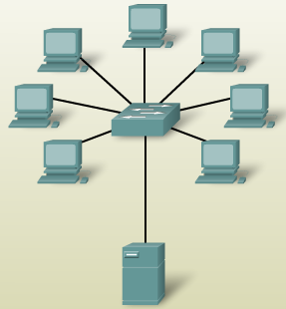
Switch
Frame comes in. Switch regenerates it and forwards it to destination only.
Segments network into separate collision domains.
More expensive but better performance than hub

Slide 7
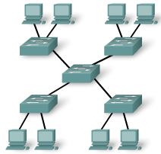
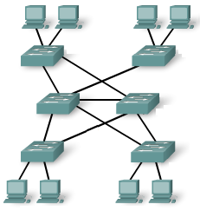

Arranging switches
Star for small networks
Extended Star for larger networks, perhaps on several floors
Mesh to give redundancy – fault tolerance.

Slide 8

Choice of switch ports
10 Mbps?
100 Mbps?
10/100 Mbps?
1Gbps?
UTP or fibre optic?
Allow for growth.
Modular switch?
What have our switches got?

Slide 9
Choice of router
Expandability – will you want to add extra modules?
Media – serial ports, Ethernet ports, UTP or fibre optic, how many of each?
Operating System Features – what do you want the router to do? Will you have enough memory to upgrade the operating system?
What ports have our routers got?

Slide 10
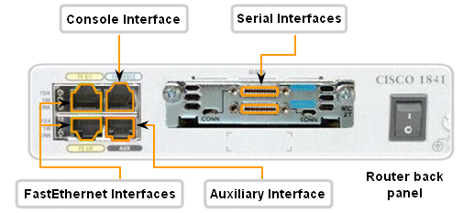
Router interfaces

Slide 11
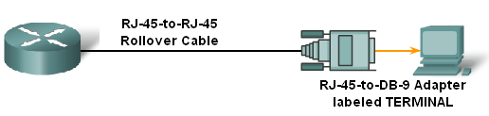
Rollover cable - console
Our rollover cables a DB9 connector at one end and do not need an adaptor.
Rollover cables with RJ45 connectors both ends need an adaptor.

Slide 12
Hyperterminal
You run a terminal emulator program such as Hyperterminal on the PC in order to configure the router.
Windows has a built in Hyperterminal program.
We usually use Hilgraeve Hyperterminal.

Slide 13
Hyperterminal
You set up the PC’s serial port as follows:
  Bits per second: 9600 bps
  Data bits: 8
  Parity: None
  Stop bits: 1
  Flow control: None

Slide 14


Total length of cable allowed for UTP connection?
Distance to allow between host and switch or hub?
Distribution facility or Telecommunications room
Horizontal cable
Length?
Wall socket
Patch panel
Patch cable
Patch cable
Length?
Length?
Host
Switch

Slide 15
Total length of cable allowed for UTP connection? 100 metres
Distance to allow between host and switch or hub? 50 metres (cable runs are not straight)
Distribution facility or Telecommunications room
Horizontal cable
90 metres
Wall socket
Patch panel
Patch cable
Patch cable
5 metres
5 metres
Host
Switch

Slide 16
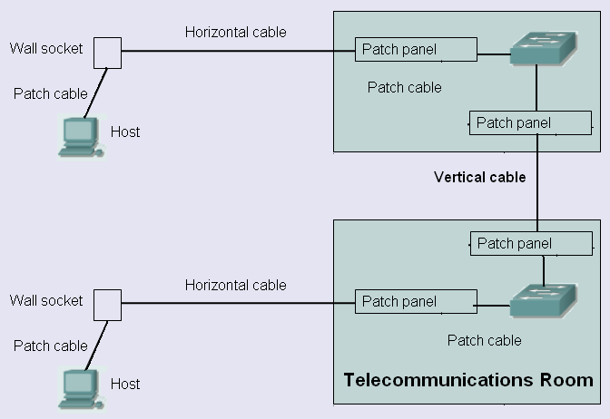
Horizontal and vertical cable

Slide 17
Which cable?
Length: UTP up to 100m, fibre optic longer
UTP inside building. Fibre optic in or out.
Cost: UTP cheaper than fibre optic
Bandwidth: is it enough to meet requirements?
Ease of installation: UTP is easier.
EMI/RFI noise: may need fibre optic.
High capacity link: may need fibre optic.

Slide 18

Attenuation
As a signal propagates (travels) it becomes weaker. This is attenuation
If a signal becomes too weak then the receiving host cannot tell if it is meant to be a 0 or a 1.
This limits cable length.

Slide 19
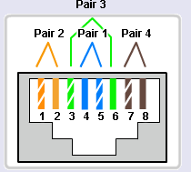
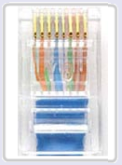
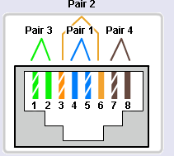
USB cable reminder
Straight through cable – same both ends
Crossover cable – 1 swaps with 3, 2 swaps with 6

Slide 20
Why cross over?
Transmit needs to connect to receive
Transmit
1
Transmit
2
Receive
3
Receive
6
The crossing over can happen in the cable or inside a device.

Slide 21




Where is the cross over?
Switches and hubs have ports that manage the cross over inside
PCs and routers have ports where there is no crossover inside
Straight through cable needed if you link a device in one group to a device in the other group
Crossover cable needed if you link devices in the same group

Slide 22
Switch ports
Most switch ports are normally the MDIX type. They manage the crossing over internally.
Some switch ports can be changed between MDI and MDIX either with a switch or in the configuration.
Some switches can detect which sort of port is needed and change automatically.

Slide 23
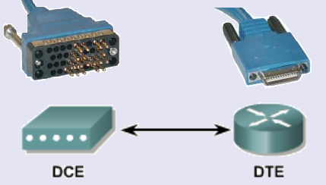
WAN connection
V35 cable or EIA/TIA-232
EIA/TIA-449
X21, V24,
HSSI
Supplier’s network
Supplier’s device on customer’s premises
provides clocking
Customer’s router

Slide 24
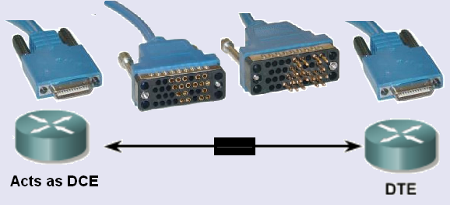
Simulating WAN in the lab

Slide 25
Split network into subnets
To cut down the number of broadcasts. Splitting the network into subnets also splits it into separate broadcast domains.
To provide different facilities for different groups of users.
For security. Traffic between subnets can be controlled.

Slide 26
Addressing the network(s) 1
Start with a topology diagram.
All on one network, or will it be split into subnets?
How many subnets?
How many network bits do we need?
n bits can provide 2^{n} addresses
How many bits are left for hosts?

Slide 27
Addressing the network(s) 2
On each subnet, count the number of:
Router interfaces
Switches
Servers
Admin workstations
General workstations
Printers
IP phones

Slide 28
Addressing the network(s) 2
How many host bits do we need?
n bits can provide 2^{n} addresses
One for network, one for broadcast
So 2^{n} – 2 host addresses.
2^{n} – 2 could be 2, 6, 14, 30, 62, 126, 254, 510, 1022, 2046 and so on.
Go for a number big enough to give us enough addresses.

Slide 29
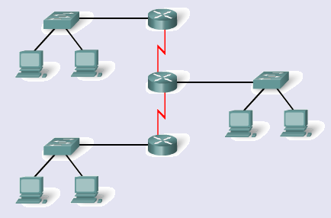
How many subnets?
Include point to point links.

Slide 30
Bits to borrow
n bits borrowed for subnetting gives you 2^{n} subnets.
So 1 bit gives 2 subnets, 2 bits give 4 subnets, 3 bits give 8 subnets and so on.
If you need 5 subnets, how many bits do you borrow?
If you need 10 subnets, how many bits do you borrow?
3
4

Slide 31
Addressing example
The example given in the curriculum shows subnetting without VLSM using 172.16.0.0/22. (172.16.0.0 – 172.16.3.255)
They produce 4 subnets each with 510 addresses.
This is impossible. It will be corrected.
You can do it if you start with 172.16.0.0/21 (172.16.0.0 – 172.16.7.255)

Slide 32
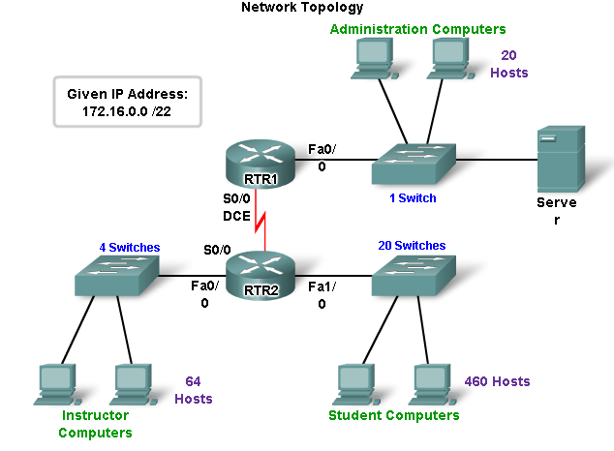
Addressing example no VLSM
172.16.0.0/21

Slide 33
What we have and need
Given IP address 172.16.0.0/21
That’s 172.16.0.0 to 172.16.7.255
4 subnets needed:
  Student LAN has 481 hosts
  Instructor LAN has 69 hosts
  Administrator LAN has 23 hosts
  WAN has 2 hosts

Slide 34
Without VLSM – same size subnets
Biggest subnet has 481 hosts.
Formula for hosts is 2^{n} – 2
n = 9 gives 510 hosts (n = 8 gives only 254)
So 9 host bits needed.
That means 32 – 9 = 23 network bits
/23 or subnet mask 255.255.254.0

Slide 35
Network addresses
/23 so subnet mask in binary is
11111111 11111111 11111110.00000000
Octet 3 is the interesting one.
Value of last network bit in octet 3 is 2
So network numbers go up in 2s
  172.16.0.0
  172.16.2.0
  172.16.4.0
  172.16.6.0

Slide 36
Subnet with no VLSM
Network | Subnet address | Host range | Broadcast address
Student | 172.16.0.0/23 | 172.16.0.1 - 172.16.1.254 | 172.16.1.255
Instructor | 172.16.2.0/23 | 172.16.2.1 - 172.16.3.254 | 172.16.3.255
Admin | 172.16.4.0/23 | 172.16.4.1 - 172.16.5.254 | 172.16.5.255
WAN | 172.16.6.0/23 | 172.16.6.1 - 172.16.7.254 | 172.16.7.255

Slide 37
Addressing example with VLSM
172.16.0.0/22 is OK

Slide 38
What we have and need
Given IP address 172.16.0.0/22
That’s 172.16.0.0 to 172.16.3.255
4 subnets needed:
  Student LAN has 481 hosts
  Instructor LAN has 69 hosts
  Administrator LAN has 23 hosts
  WAN has 2 hosts

Slide 39
With VLSM
Student subnet has 481 hosts.
Formula for hosts is 2^{n} – 2
n = 9 gives 510 hosts (n = 8 gives only 254)
So 9 host bits needed.
That means 32 – 9 = 23 network bits
/23 or subnet mask 255.255.254.0
Network address 172.16.0.0
Broadcast address 172.16.1.255

Slide 40
With VLSM
Instructor subnet has 69 hosts.
Formula for hosts is 2^{n} – 2
n = 7 gives 126 hosts (n = 6 gives only 62)
So 7 host bits needed.
That means 32 – 7 = 25 network bits
/25 or subnet mask 255.255.255.128
Network address 172.16.2.0
Broadcast address 172.16.2.127

Slide 41
With VLSM
Admin subnet has 23 hosts.
Formula for hosts is 2^{n} – 2
n = 5 gives 30 hosts (n = 4 gives only 14)
So 5 host bits needed.
That means 32 – 5 = 27 network bits
/27 or subnet mask 255.255.255.224
Network address 172.16.2.128
Broadcast address 172.16.2.159

Slide 42
With VLSM
WAN subnet has 2 hosts.
Formula for hosts is 2^{n} – 2
n = 2 gives 2 hosts
So 2 host bits needed.
That means 32 – 2 = 30 network bits
/30 or subnet mask 255.255.255.252
Network address 172.16.2.160
Broadcast address 172.16.2.163

Slide 43
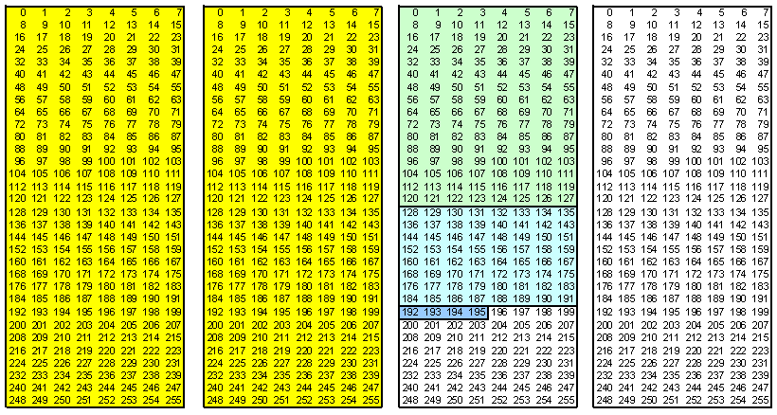
Visually with VLSM
172.16.0.0
172.16.1.0
172.16.2.0
172.16.3.0
Instructor
Student
Admin
WAN

Slide 44
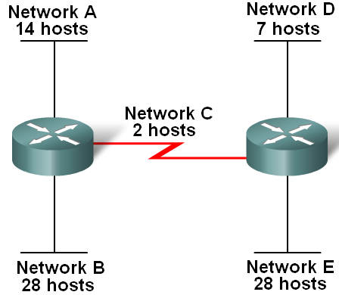
Case 2. Given 192.168.1.0/24

Slide 45
Subnet 192.168.1.0/24
2 subnets with 28 hosts each (largest)
5 host bits 2⁵ - 2 = 30 would be just enough
But allow for expansion: 6 host bits give 62
Network bits 32 - 6 = 26
so /26 or subnet mask 255.255.255.192
Network | Subnet address | Host range | Broadcast address
B | 192.168.1.0/26 | 192.168.1.1 - 192.168.1.62 | 192.168.1.63
E | 192.168.1.64/26 | 192.168.1.65 - 192.168.1.126 | 192.168.1.127

Slide 46
Subnet 192.168.1.1/24
1 subnets with 14 hosts
4 host bits 2⁴ - 2 = 14 would be just enough
But allow for expansion: 5 host bits give 30
Network bits 32 - 5 = 27
so /27 or subnet mask 255.255.255.224
0-127 range already used
Network | Subnet address | Host range | Broadcast address
A | 192.168.1.128/27 | 192.168.1.129 - 192.168.1.158 | 192.168.1.159

Slide 47
Subnet 192.168.1.1/24
1 subnets with 7 hosts
4 host bits 2⁴ - 2 = 14 is enough
Network bits 32 - 4 = 28
so /28 or subnet mask 255.255.255.240
0-159 range already used
Network | Subnet address | Host range | Broadcast address
D | 192.168.1.160/28 | 192.168.1.161 - 192.168.1.174 | 192.168.1.175

Slide 48
Subnet 192.168.1.1/24
1 subnets with 2 hosts
2 host bits 2² - 2 = 2 is enough
Network bits 32 - 2 = 30
so /30 or subnet mask 255.255.255.252
0-175 range already used
Network | Subnet address | Host range | Broadcast address
C | 192.168.1.176/30 | 192.168.1.177 - 192.168.1.178 | 192.168.1.179

Slide 49
Subnet plan with VLSM
Network | Subnet address | Host range | Broadcast address
B | 192.168.1.0/26 | 192.168.1.1 - 192.168.1.62 | 192.168.1.63
E | 192.168.1.64/26 | 192.168.1.65 - 192.168.1.126 | 192.168.1.127
A | 192.168.1.128/27 | 192.168.1.129 - 192.168.1.158 | 192.168.1.159
D | 192.168.1.160/28 | 192.168.1.161 - 192.168.1.174 | 192.168.1.175
C | 192.168.1.176/30 | 192.168.1.177 - 192.168.1.178 | 192.168.1.179

Slide 50
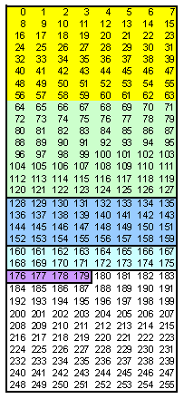
Visual
B
One octet available
E
A
D
C

Slide 51
Have we survived this marathon?
The End

